Slide 1
PROCESSES

Slide 2
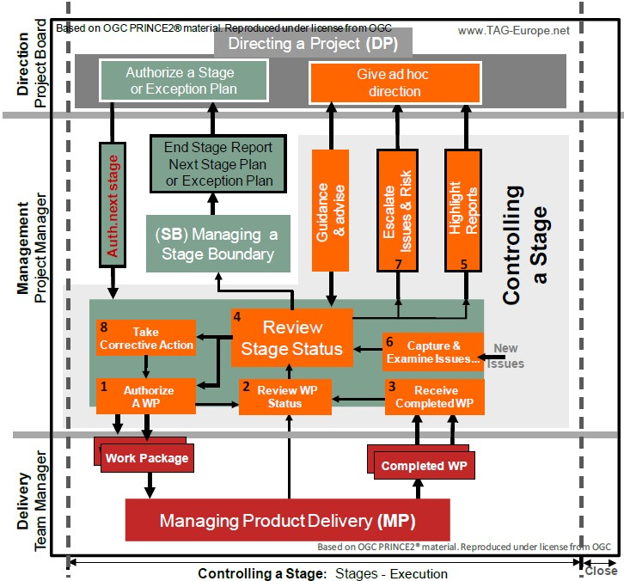

Slide 3
Controlling a Stage
Controlling a Stage
o the
The purpose of the Controlling a Stage process is to assign work to be done t specialist teams, monitor such work, manage risks and issues, report progress of the stage to the Project Board, and if required take corrective actions to ensure that the stage remains within tolerance in terms of the six aspects (Scope, Time, Cost, Risk, Quality and Benefits).
The objective of the Controlling a Stage process is to ensure that:
  Attention is focused on the delivery of the products.
Keep Risks and Issues under control.
Keep the Business Case under review.
Deliver the products for the stage to the agreed quality within agreed cost and time & achieve the defined benefits.

Slide 4
Controlling a Stage
Controlling a Stage
The key activities performed in this process are :
Authorize a Work Package as a result of approval of a stage or an exception plan by the board. Obtain the product descriptions of the entire product to be included in the Work Package and define the techniques, processes and procedures to be used.
Review a Work Package Status through Checkpoint Reports and receive completed Work Packages
Review the team plan with team manager to forecast whether the work will be completed on time and budget.
Review the Project Initiation document for the project controls such as reporting method required, Quality Management Strategy and the
Review the stage status, report highlights and take corrective actions if required.
Watching for, assessing and dealing with issues and risks. This includes maintaining Issue and Risk registers. Escalate Issues and Risks

Slide 5
Controlling a Stage
Quality standards required, Configuration management strategy for how the products are to be hand over
Reviewing the product quality and triggering the new Work Package
or update the existing ones.
Review entries in the Quality Register related to products in the work package to understand the current status of quality management activities and ensure that each product in the Work Package has gained its requisite approval.
Confirm that the configuration item record for each approved product is updated
Update the stage plan to show the Work Package as completed Review the Stage Plan (current stage) for products to be produced, cost, effort and tolerances available

Slide 6
Managing Product Delivery
Purpose
The purpose of the Managing Product Delivery Process is to manage and control the work between the Project Manager and the Team Manager by placing certain formal requirements on the accepting, executing, and delivery of products.
Objective:
The objective of the Managing Product Delivery Process is to ensure that: Products assigned to the team are authorized and agreed.
The team is clear about what has to be produced & understands the effort, time and cost.
The planned products are delivered to the expectations and within tolerance.
Accurate progress information is provided to the Project Manager by the Team
Manager.

Slide 7
Managing Product Delivery
The key activities in this process are:
Work on products allocated to the team is authorized and agreed
Team Managers, team members and suppliers are clear as to what
is to be produced and what is the expected effort, cost or timescales
The planned products are delivered to expectations and within tolerance
Accurate progress information in the form of checkpoint reports is provided to the Project Manager at an agreed frequency to ensure that expectations are managed.

Slide 8
Managing Product Delivery
Products that are created or updated during this process are:
Team plans with actual dates.
Risk register with any identified work package level risks.
Quality register with all quality work that is being undertaken.
Configuration Item Records with the latest status of products produced.
Project Issues with status information and impact analysis for current or new issues identified.
Checkpoint Reports providing regular progress information to the Project Manager.

Slide 9
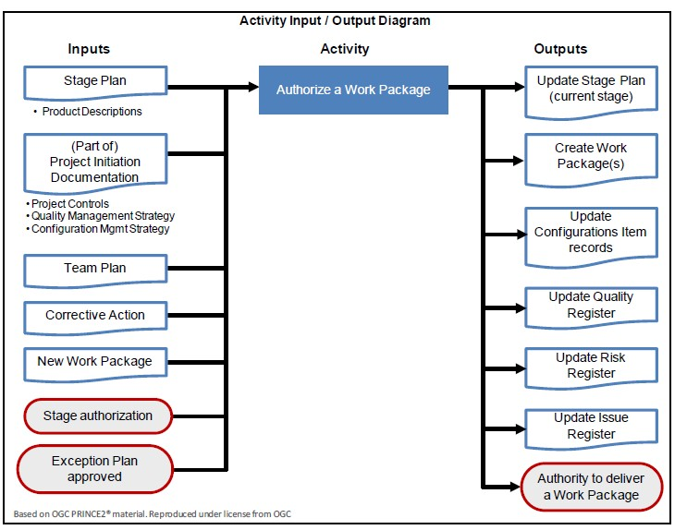
Controlling a Stage
Authorize work package

Slide 10
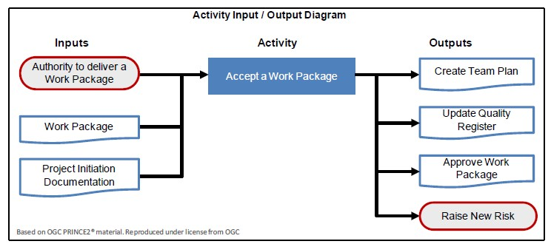
Managing Product Delivery
Accept a Work Page

Slide 11
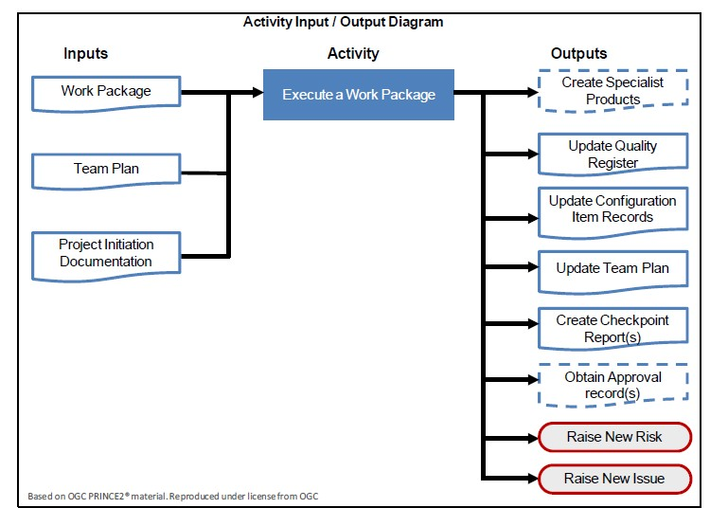
Managing Product Delivery
Execute a Work Page

Slide 12
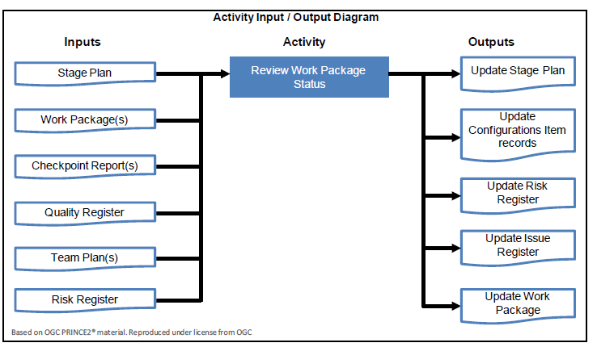
Controlling a Stage
Controlling a Stage
Review work package, the main input file in this activity is checkpoint report , a time driven report through which Team manager updates project manager on the status of work.

Slide 13
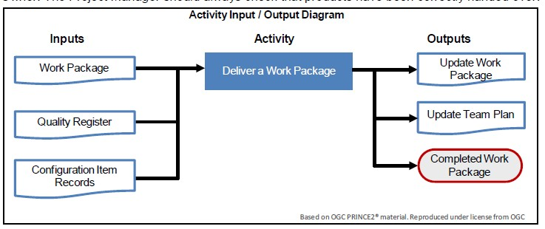
Managing Product Delivery
Deliver a Work Page

Slide 14
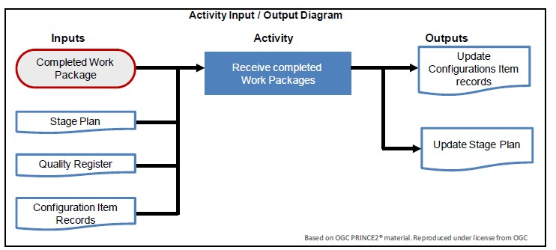
Controlling a Stage
Receive completed work package

Slide 15
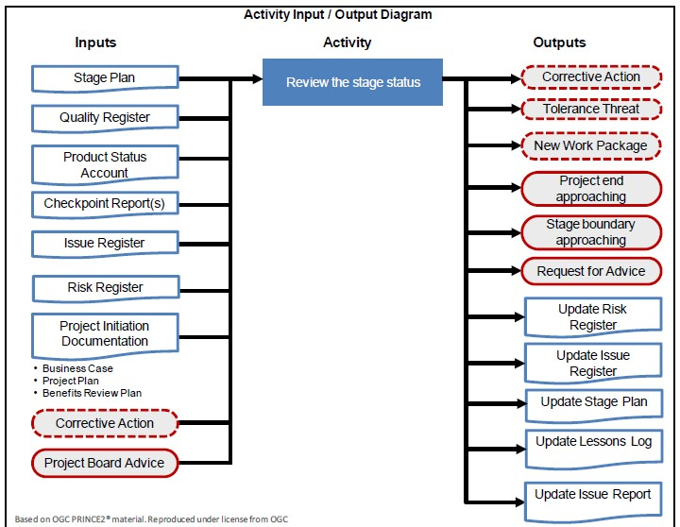
Controlling a Stage
Review the stage status

Slide 16
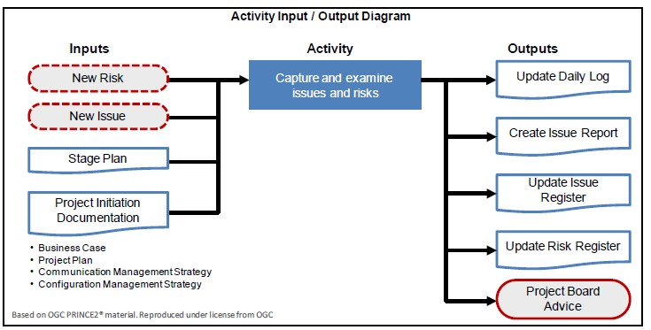
Controlling a Stage
Capture and Examine Risks and Issues

Slide 17
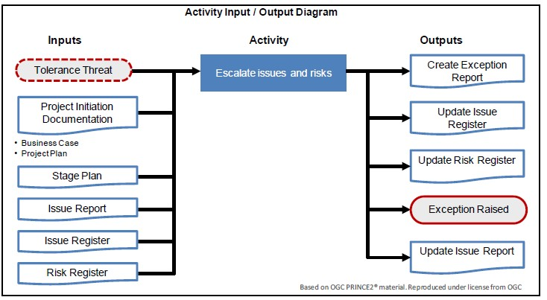
Controlling a Stage
Escalate Issues and Risks

Slide 18
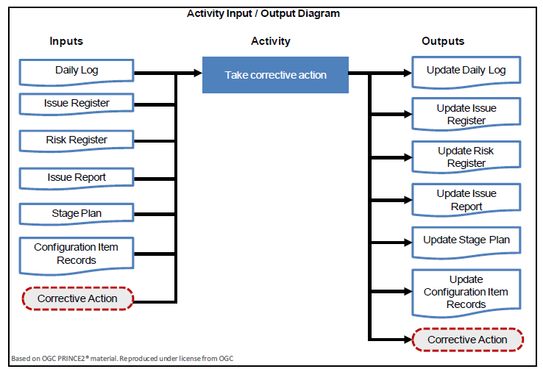
Controlling a Stage
Take corrective actions

Slide 19
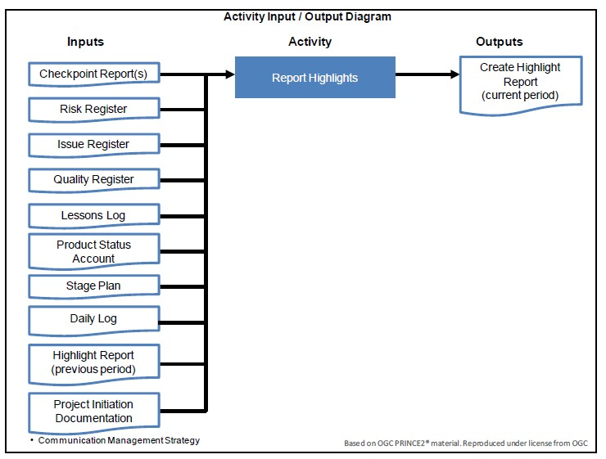
Controlling a Stage
Report Highlights, Project Manager uses Highlight reports to update the Project Board about the stage status. The frequency of these reports is defined in communication management strategy

Slide 20
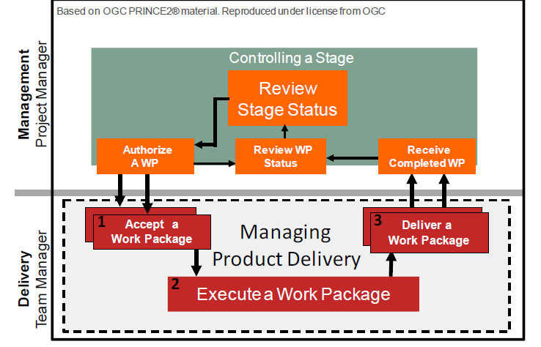
Managing Product Delivery

